Slide 1
CAR Champion Calibration Meeting CAR Review
Team “C”
Tovia Bat-Leah (CAR 13391183 Finding & CAR 133911731 Observation)
Jim Oates (Unable to present due to Audit commitment)
Jeff Lietz (CAR 133911586 Finding & CAR 133912110 Exemplary)

Slide 2
CBS Score Card

Slide 3
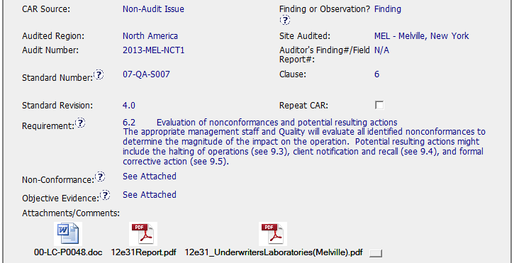
Pinch-Hitter
00-LC-P0048
Notes:
This CAR Finding is a “Non-Audit Issue” which was internally created as the result of non-conforming test results under guidelines established within the Proficiency Test Program (PTP).
Efforts to maintain accurate and consistent testing among various labs drives the need for closer evaluation of inconsistent results.
This CAR is still in process
Referenced Standard does not exist and cannot be located in Obsolete Databases.
The Standard 07-QA-S007 (?) was rolled into 00-LC-P0048 and obsoleted while CAR was in process. References to written requirements are no longer available.
CAR Champion was not aware that a change had taken place.
How would they have been notified or made aware?
Should the requirements be re-written and re-referenced?
The need to review the entire CAR prior to closing is evident!
If copy of older Standard had been attached, it would have been easier to cross-reference requirements and align them with the newer document.
Requirements written into the CAR are reflected in the newer document.

Slide 4

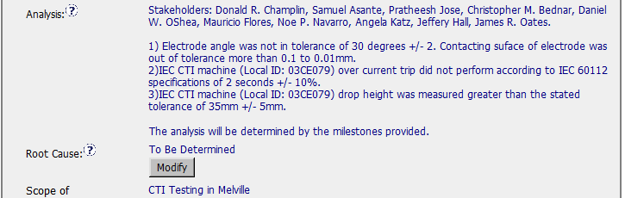
“I need more power Scotty…”
Notes:
Analysis
Good job of identifying Stakeholders
Several factors contributing to poor results are clearly stated, however, ample room for more questions;
Why were items out of tolerance?
Why did the over-current trip not perform as planned?
Why was the drop height incorrect?
Analytical Process and Scope of Problem is missing, however, the Milestones are being leveraged for investigation which will inherently reveal a more defined course of action as they progress.
Root Cause
Pending completion based on results of “Analytical Milestones”
How can you attempt Corrective Action when you have not identified the Root Cause?
Scope
Limited to Melville Testing Facility - Local

Slide 5
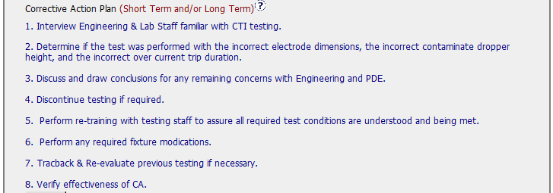
Split Decision
Analysis ?
How will we know?
Notes:
Corrective Action Plan
Items 1, 2, and 3 appear to belong in the Analysis portion of the CAR
Item 4 leads me to ask what must occur to determine if testing must be discontinued?

Slide 6
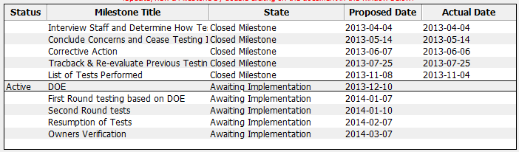
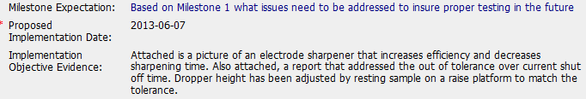
The Devil is in the details!
?
Notes:
Milestones - General
Aligned with Corrective Action Plan
Containment is not an issue in this case
Final Verification included
First Milestone
“Interview Engineering & Lab Staff familiar with CTI testing. By speaking with Dan OShea, Mauricio Flores, Pratheesh Jose, and Sam Asante I can obtain insight and specific information in regards to test performance and details.”
OE reflects three questions asked of one person.
Third Milestone
An electrode sharpener was developed to improve efficiency based on outcome of the first milestone, however, the question and answer did not appear to warrant this direction:
My Third Question: The electrode contact surface and electrode angle was out of tolerance, do you believe even though they were close to being in tolerance, that these measurements would have a great effect on the results? Dan’s Response: Minimal, the measurements were out, however the electrode – sample contact was not affected.
Fourth Milestone
Indication made in OE that determination cannot be made without further testing.
This does not appear to align with the Expectation: “Evidence of traceback and re-evaluation if needed or documentation showing traceback was not required”
Milestone Six through Ten in process as of 11/15/2013

Slide 7
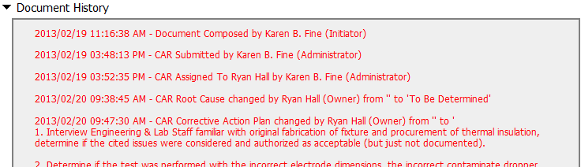
Time keeps on ticking, ticking….
Notes:
Date Extensions – Four Extensions with one extending 32 days.
Extension requests for 30 days or more, or if three or more extensions have already been granted: these extensions cannot be granted without the approval of the CAR Process Owner. (My guess is that this CAR Champion has permission to do this!)
2013/03/28 03:30:37 PM - Implementation Date Extension Approved From 2013/03/28 To 2013/04/04
2013/04/30 03:48:55 PM - Implementation Date Extension Approved From 2013/04/30 To 2013/05/14
2013/06/28 11:40:53 AM - Implementation Date Extension Approved From 2013/06/28 To 2013/07/25
2013/11/12 10:14:54 AM - The milestone- 'DOE' due date was extended by 32 days

Slide 8
Finding CAR # 133911586 (Motomu Kawano)

Slide 9
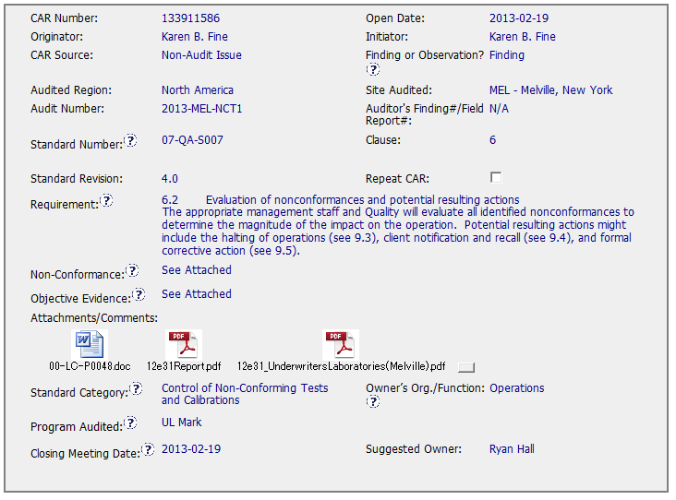
CAR# 133911586
Non-conformance and Objective evidence has to be written more in detail. I was able to guess that this is about IFM test result of CTI testing, however, I think it should be written here.
[Competitiveness] (C) - Analysis shows clear path to root cause and scope; stakeholders identified
[Competitiveness] (C) - Root cause statement is succinct, reasonable, complete (Shows ‘N/A’ for observations)
[Competitiveness] (C) - Corrective actions fix the objective evidence and other problems found; address entire root cause and scope. For observations, they do not go beyond fixing the objective evidence
Notes:
For the CAR# 133911678:
[CAR Review based on 00-QA-S0006 - Corrective Action Request Process]
In the session of “Non-Conformance”, there are TWO (2) discrepancies:
Failure conducting Management Review in the required time period, and
Missing input element in the Management Review process. There should be two separate root cause analysis.

Slide 10
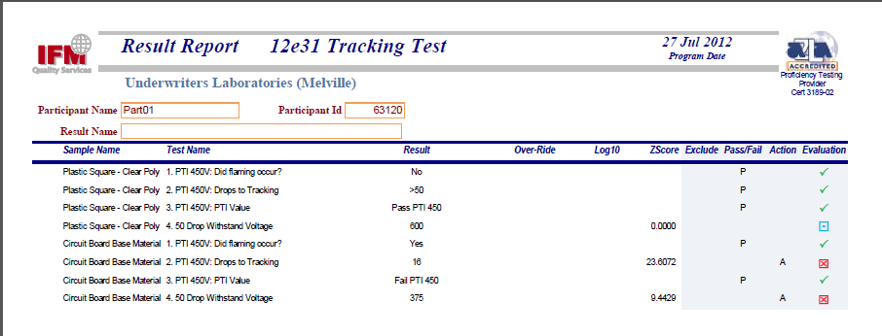
CAR# 133911586
Although there is no statement in the CAR, I guess the issue of this CAR is 2 failure of IFM testing as above.
Notes:
For the CAR# 133911678:
[CAR Review based on 00-QA-S0006 - Corrective Action Request Process]
In the session of “Non-Conformance”, there are TWO (2) discrepancies:
Failure conducting Management Review in the required time period, and
Missing input element in the Management Review process. There should be two separate root cause analysis.

Slide 11
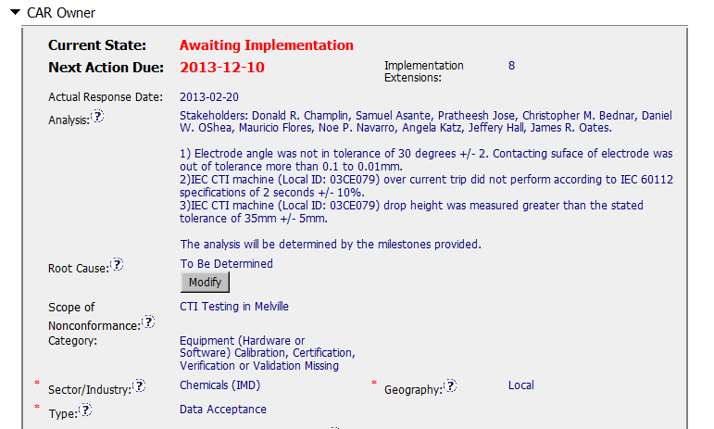
CAR# 133911586 (Analysis)
Stakeholders are appropriately written. However, there is no standards and SOP specified in Analysis.
It seems that Analysis and Root cause will be updated as it progresses.
[Collaboration] (C) – Engage with CAR Owner to get deeper analysis.
[Competitiveness] (C) – Analysis shows clear path to root cause and scope and stakeholders identified.
[Competitiveness( (C) - Root cause statement is simple, reasonable and complete.
[Integrity] (T) – Most appropriate ‘category’, ‘type’, ‘geography’ are selected.
Notes:
Analysis – clear path to root cause; stakeholders identified
There are TWO (2) discrepancies: a) Failure conducting Management Review in the required time period, and b) Missing input element in the Management Review process. There should be two separate root cause analysis.
The “5 WHYs” approach hasn’t been utilized well because it doesn’t seem that it is able to identify the possible causes. For example, as mentioned in the “Analysis” field that “There was no general framework to set up an utilizable management review in that period. Thus the issue of the review has been postponed….” It is questionable whether it is specifically illustrated in the DEWI Quality Manual about the process and framework of Management Review, or the process is not even existing, or other reasons resulting now Management Review is not executed in the required timeframe after a personnel left the organization? The “5 WHYs” analysis can go further deeper.
In addition, does a statement “… Thus the issue of the review has been postponed.” mean that does the previous Management Review officially determine to be postponed? If yes, is there any supporting evidence?
And there is no analysis related to illustrate why “Recommendation for improvement” is not covered as input in the process of Management Review stated in the current DEWI Quality Manual.

Slide 12
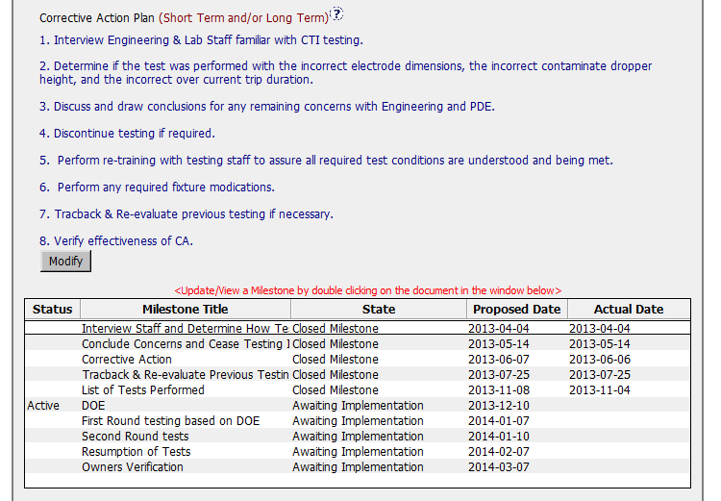
CAR# 133911586 (CAP)
Determination what has to be done was not clear enough at the time. Many things should have done in Analysis section were carried over to Milestones.
[Competitiveness] (C) – Corrective actions fix the objective evidence and other problems found; address entire root cause and scope.
[Competitiveness] (C) – Milestones address containment and owner’s verification; completed per milestone expectations.
Notes:
Root Cause – is succinct; reasonable and complete based upon the analysis
Not quite sure whether how would the process and initiator of the Management Review be outlined in the Quality Manual or the related SOPs. For the instance, is there a deputy person being determined to keep running of the Management Review process for any reason the initiator is absence.
Absence of the initiator in this case is not necessary resulting the failure of the quality process. [Refer to back to the result of the root cause analysis]
As mentioned above, there should be two separate root cause analysis. Another root cause is not addressed and identified.
Scope – tells how widespread the problem is
The widespread of the discrepancy has not been addressed in this field. e.g. How would it be affected by division, operation team, function, area/region, and the time period?
Remarks: Prior to the CAR review, if I were the CAR Administrator, it is necessary to clarify what are the differences to the organizations of DEWI and DEWI Wilhelmshaven, are they different entities? And is there any operation connection to DEWI-OCC?

Slide 13
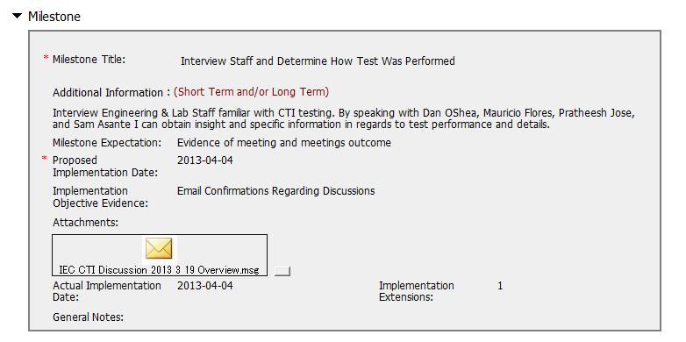
CAR# 133911586 (1st Milestone)
I think this has to be done in Analysis period.
GOOD!!! [Collaboration] (C) – (L) Referenced communications are attached as needed.
Notes:
Category
→ Satisfaction
Sector/Industry
→ Satisfaction
Type
→ Satisfaction
Geography – apparent from the analysis
Not clearly illustrated in the field of “Analysis” to support it to be “Regional”.

Slide 14
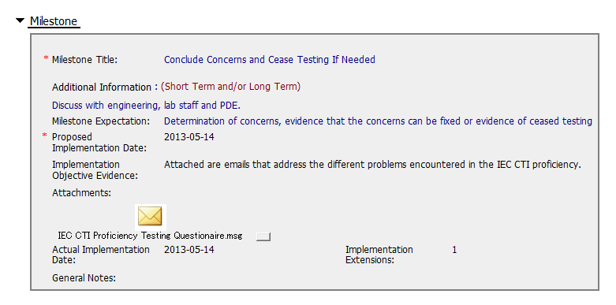
CAR# 133911586 (2nd Milestone)
It seems that Milestone expectation and Implementation objective evidence is different each other.
[Competitiveness] (C) – Milestones completed per milestone expectation.
Notes:
Corrective Actions – fix the objective evidence
If it only addresses the Containment to the “Root Cause” recorded above, I think it is sufficient…
However, the reason of why failure conducting of previous Management Review is not addressed in the fields of “Root Cause” and “Correction Action Plan”.
Corrective Actions – address the entire root cause
As noted above, it is sufficient to cover the containment action though, the corrective action managing the root cause has not been addressed.
Again, there is no any corrective action related to address why “Recommendation for improvement” is not covered as input in the process of Management Review stated in the current DEWI Quality Manual.
Corrective Actions – address the items identified in the analysis
As noted above.
Corrective Actions – cover the scope and geography
Comment as stated in “Geography” above.

Slide 15
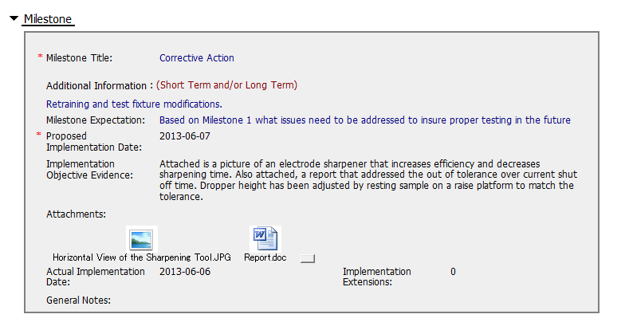
CAR# 133911586 (3rd Milestone)
Although discussion was done in 1st milestone, it seems that there is no containment plan for this CAR.
[Competitiveness] (C) – Milestones completed per milestone expectation.
Notes:
Good and no abnormality is found.

Slide 16
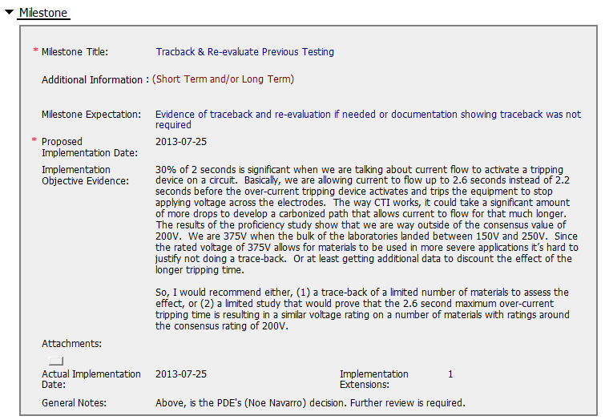
CAR# 133911586 (4th Milestone)
Now, we have justification not to do trace back. There are 2 ways to do. Let’s see what happen…
Milestone to address the entire root cause – Confusion of the role of Mentor and qualified testing staff
Notes:
Milestones – address containment unless CAP indicates reason why not required
Milestone solely for containment is good but not for corrective action. [Suggest to inviting a person could read German for verification whether “Recommendation for improvement” is now covered as input in the process of Management Review.]
See below comments for corrective actions.

Slide 17
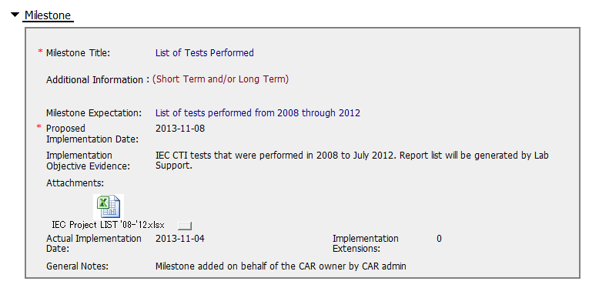
CAR# 133911586 (5th Milestone)
Now, we have the list of projects we have done.
There is no statement how this connects to future actions.
Notes:
Milestones – address containment unless CAP indicates reason why not required
Milestone solely for containment is good but not for corrective action. [Suggest to inviting a person could read German for verification whether “Recommendation for improvement” is now covered as input in the process of Management Review.]
See below comments for corrective actions.

Slide 18
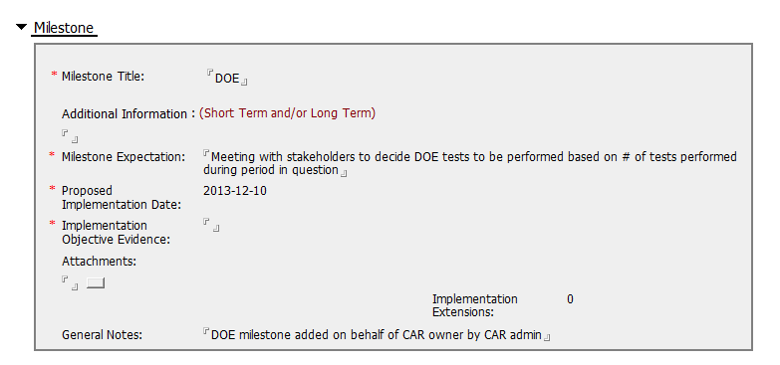
CAR# 133911586 (6th Milestone)
Here is the current situation. We should wait for decision what we can do to prevent actions. This should contain containment and corrective actions.
Notes:
Milestones – address containment unless CAP indicates reason why not required
Milestone solely for containment is good but not for corrective action. [Suggest to inviting a person could read German for verification whether “Recommendation for improvement” is now covered as input in the process of Management Review.]
See below comments for corrective actions.

Slide 19
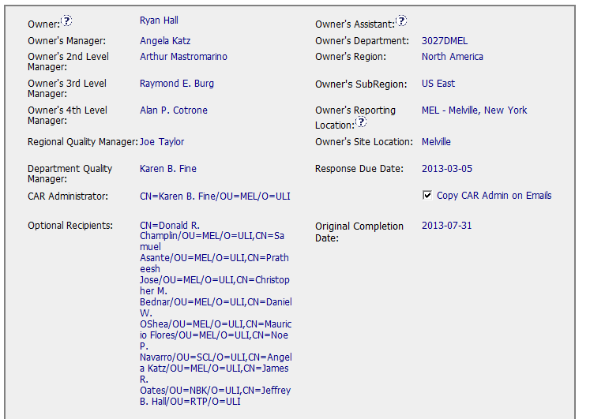
CAR# 133911586 (CAR Admin Review)
Every information in this section is OK.
[Integrity] (T) – Accurately completes the administrative fields within the CAR such as Owner’s 4th Level Manager, Optional Recipients.
Notes:
Verification – completed within 6 months of CAR closure or explanation provided; enough time is allowed for new records to be examined
Please be noted that this CAR hasn’t been closed yet. It is still under a state of “Closed Awaiting Verification”, hence, the field of “Verification Evidence” is still kept empty.
However, when both root cause identification and the related corrective action stated in 2nd milestone are questionable, the comment “The corrective action was effective” stated in the field of “CAR Effectiveness Indicator” shows too generic and lack of logical consideration…
If I were the CAR Administrator, will suggest the CAR Owner to reconsider the revisit of the current Management Review process and hence fill up the loophole resulting this nonconformance by adding one or two more milestones to illustrate and support the proper completion of corresponding efforts / activities. The timeline of last milestone for CAR Owner self-verification could be set right after completion of Management Review for Year 2013.
For the “General Notes”, shouldn’t it be an analysis field provided by CAR Owner instead of CAR Admin?

Slide 20
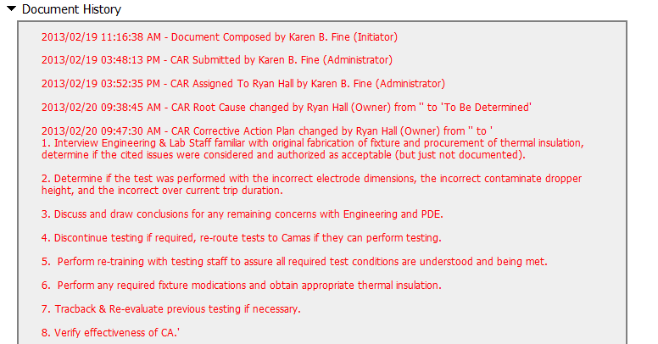
CAR# 133911586 (History)
Notes:
Extensions – within requirements (<30 days, 3 or less)
The number of extensions is still meeting the requirement.
Other than this, suggest sending e-mail in advance to remind CAR Owner separately to avoid CAR overdue and/or escalation. Put the communication with CAR Owner into the CAR DB as evidence.

Slide 21
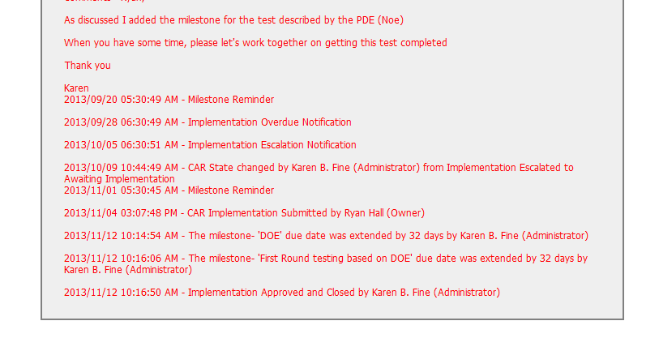
CAR# 133911586 (History)
Although I am not familiar with this CAR, there are an escalation happened in this CAR, which isn’t nice. However, I understood this is a difficult CAR.
[Collaboration] (C) – Works as a team player with other CAR Champion.
[Integrity] (T) – Acts on CARs within required timeframe.
[Integrity] (C, L) – Extensions are <30 days, 3 or less.
Notes:
Extensions – within requirements (<30 days, 3 or less)
The number of extensions is still meeting the requirement.
Other than this, suggest sending e-mail in advance to remind CAR Owner separately to avoid CAR overdue and/or escalation. Put the communication with CAR Owner into the CAR DB as evidence.

Slide 22
CAR# 133911586 (Overall Comment as of now)
Some actions to be done in Analysis session have not been conducted.
As analysis was not enough, there is no clear evidence that containment was conducted.
We are not able to know what is the current situation in detail from the CAR.
Notes:
Milestones – have final milestone for owner’s verification of effectiveness; enough time is allowed for new records to be examined
Although CAR owner self-verification is added at the last milestone, it doesn’t cover the corrective action for the failure conducting previous Management Review.
In fact, would the next round of Management Review be able to conducted on-time, it has not been addressed.
It is suggested that the verification should focus on whether the updated process and/or next round of Management Review is in place to avoid recurrence of such nonconformity.
Milestones – completed per milestone expectations
It is acceptable as Containment Action for the supporting evidence covered in the 1st milestone, i.e. Management Review Report for Year 2011 and Year 2012 [Suggest to inviting a person could read German for verification…].
However, the evidence “Attachment of the management review 2013 in milestone one. The effectiveness of the management review was reviewed by the EULA Region Quality Manager and found to be acceptable.” stated in the 2nd milestone is irrelevant while the Management Review for Year 2013 has not been conducted yet. Not sure how CAR Administrator accepts it.
In addition, for 2nd milestone, it is suggested that a statement should be provided by CAR Owner to indicate that “Recommendation for improvement” is now covered as input in the process of Management Review for Year 2011 and 2012...

